Slide 1



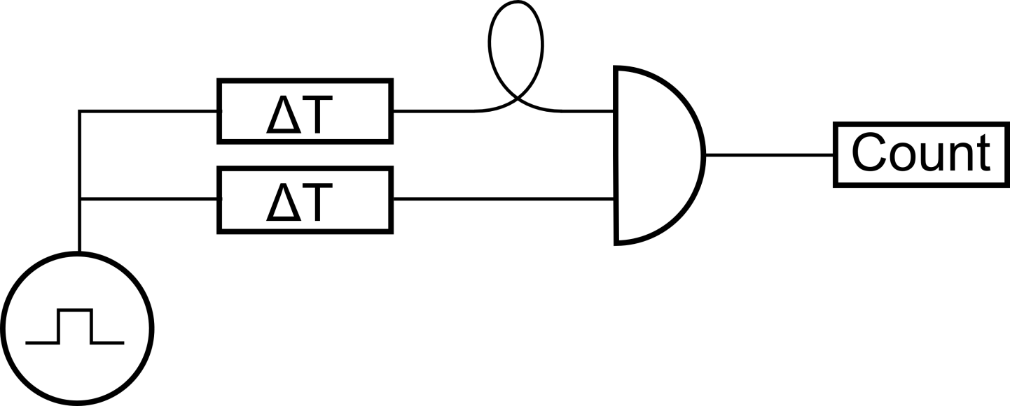
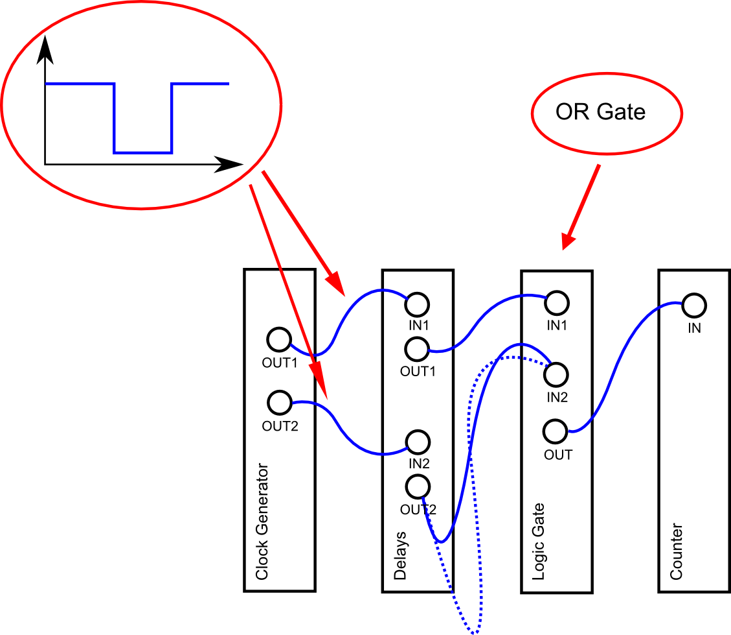


EASY-PHI CONTEST
Can you slide the trombone by 4 cm? Precisely!
Visit us at: www.easy-phi.ch

